Slide 1
Core Image Segmentation
Group: Domino. By: You Hao & Oscar

Slide 2

Aim:
Segment the individual core segments
Identify if the image is taken in UV or normal light
Images quality assessment
Plug identification.

Slide 3

Segmentation
Using Segment-Anything Model created by meta combined with OpenCV
Tuning parameter to instead whole log column instead of segments
Using clustering method to identify whole log column

Slide 4
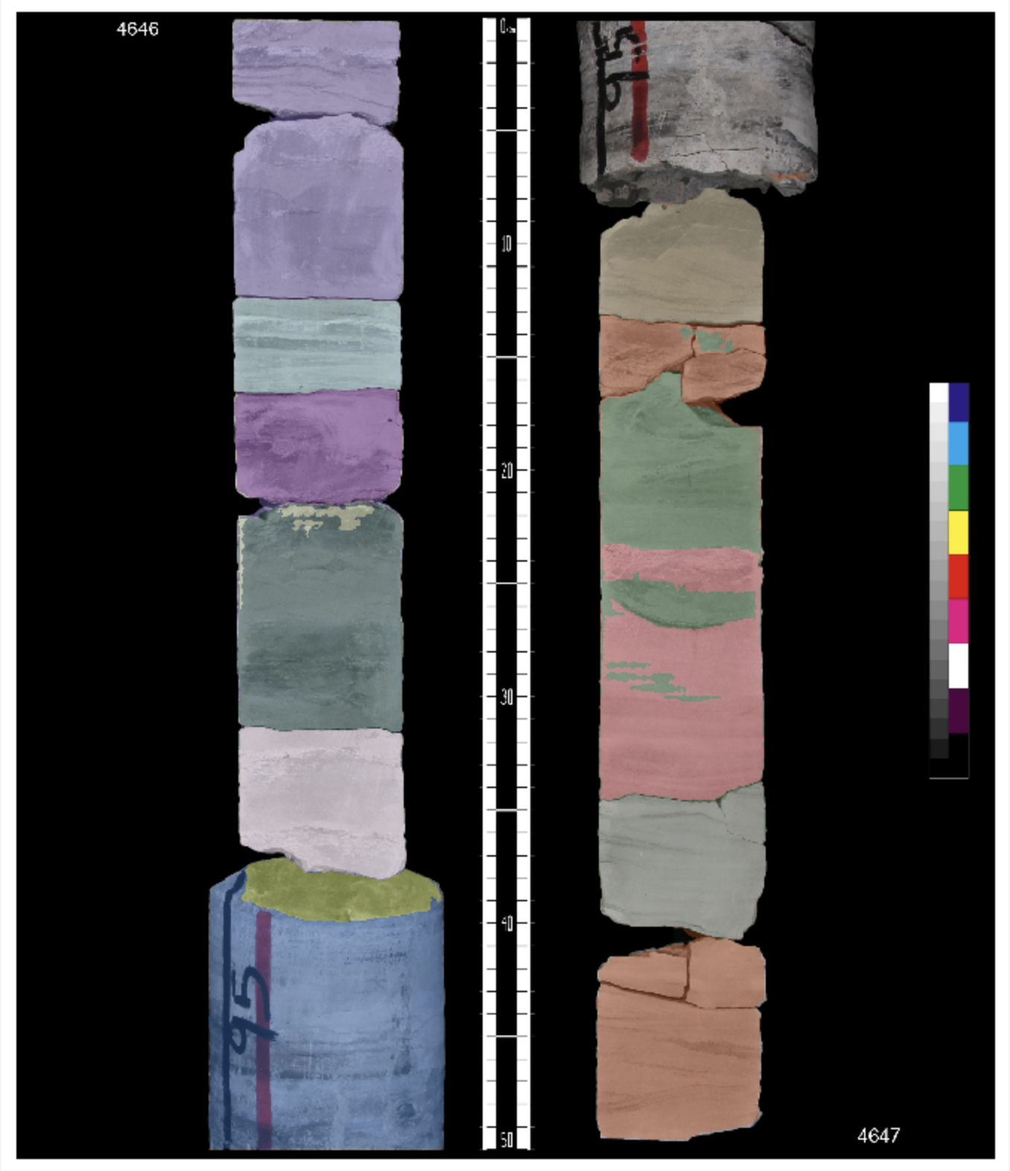

Slide 5

Determine UV or Normal Light
Using extracted log image to perform pixel-wise calculation
Using high saturation and low brightness as UV identification key

Slide 6
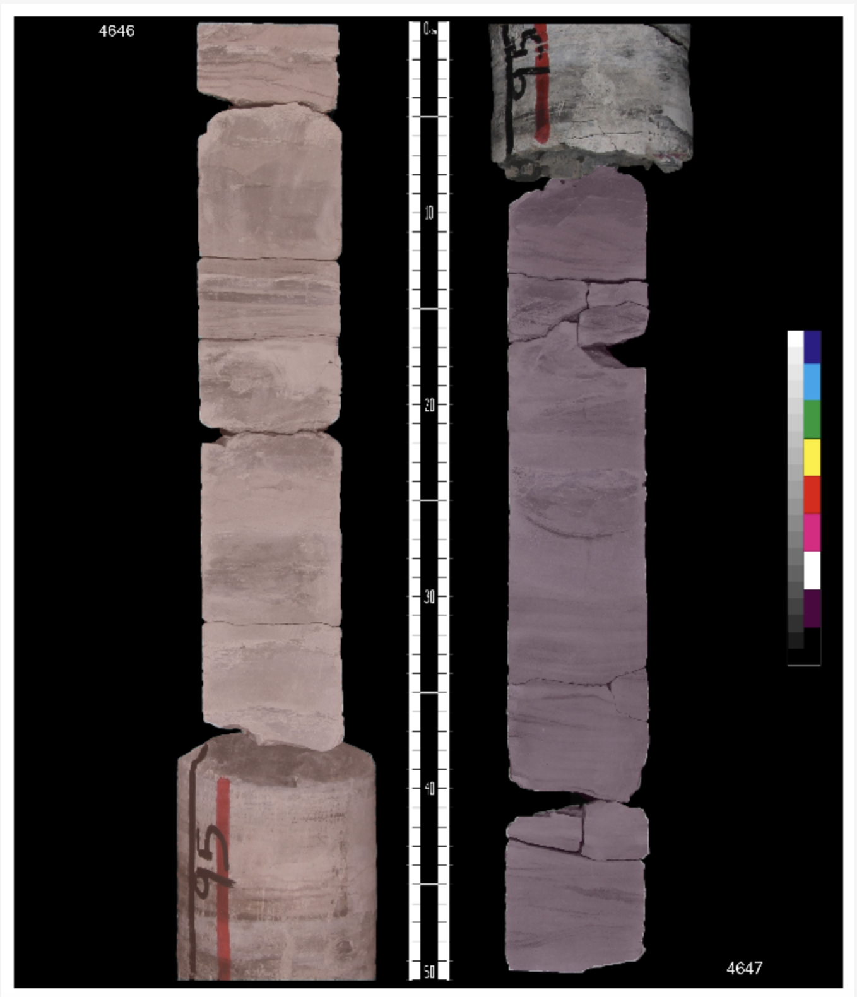

Slide 7
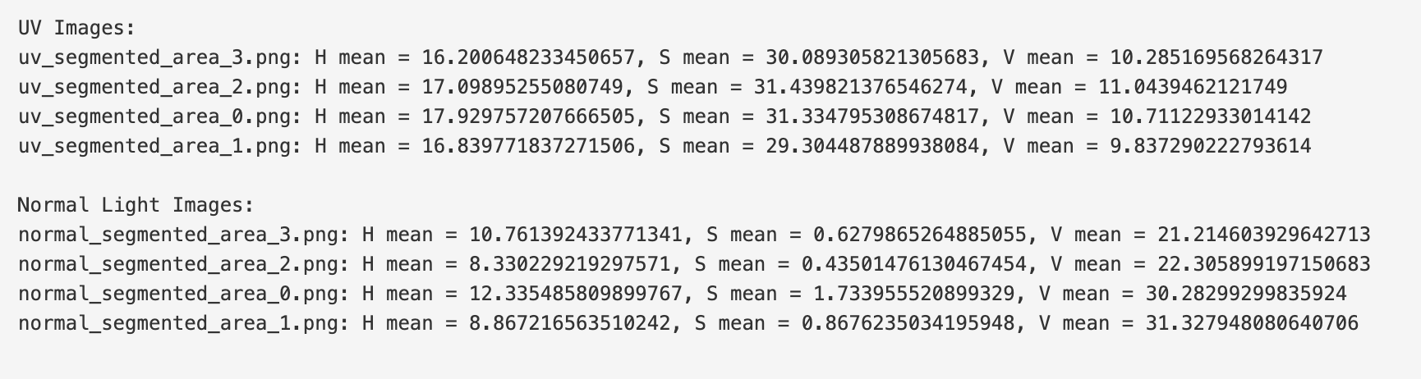

Slide 8
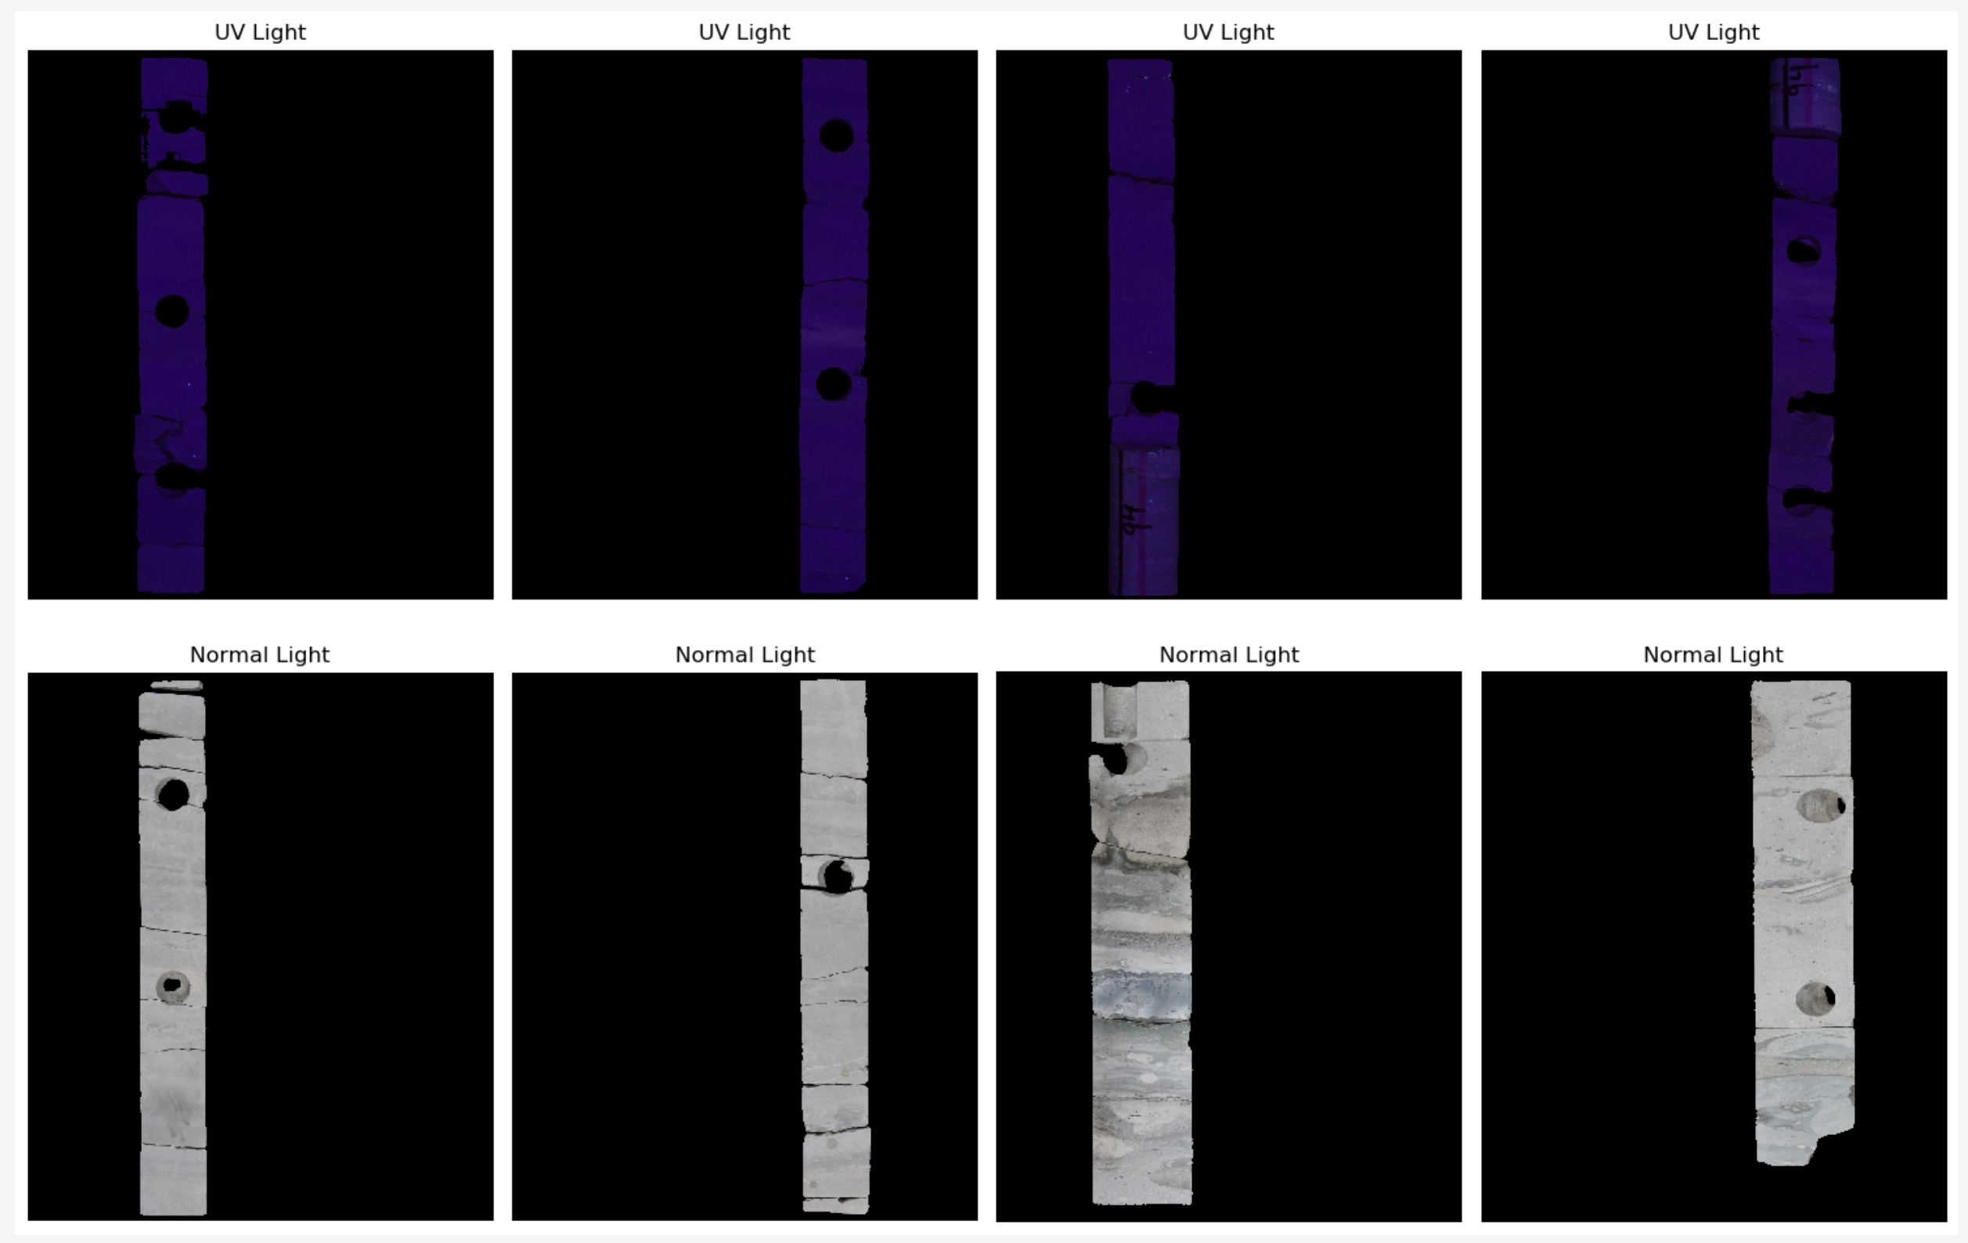

Slide 9
Plug locating
Used Hough Transformation to find circular features
Works well on well-defined circular features, but not on ellipse

Slide 10
